Slide 1

Nursing Your Baby
The Benefits of Breastfeeding
Ashley Callaway

Slide 2
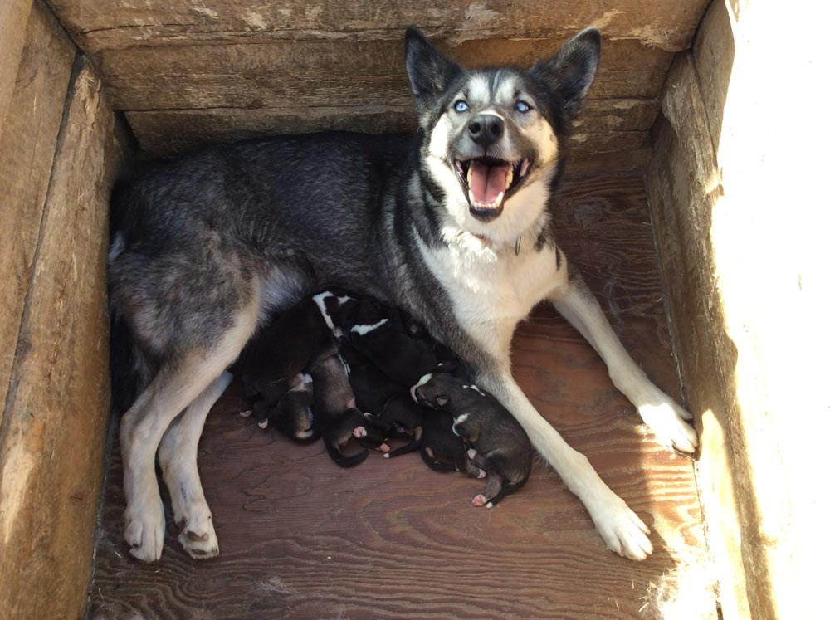
Introduction
What is the difference between seeing this...
Notes:
What does everyone think when looking at this photo? If you’re anything like me, then you’re thinking this is super cute! Oh my, a dog nursing her puppie!

Slide 3

And this?
Notes:
For me, I see almost the exact same thing. A loving mother tending to her babies. In fact, this mother does not even have to tend to as many.

Slide 4
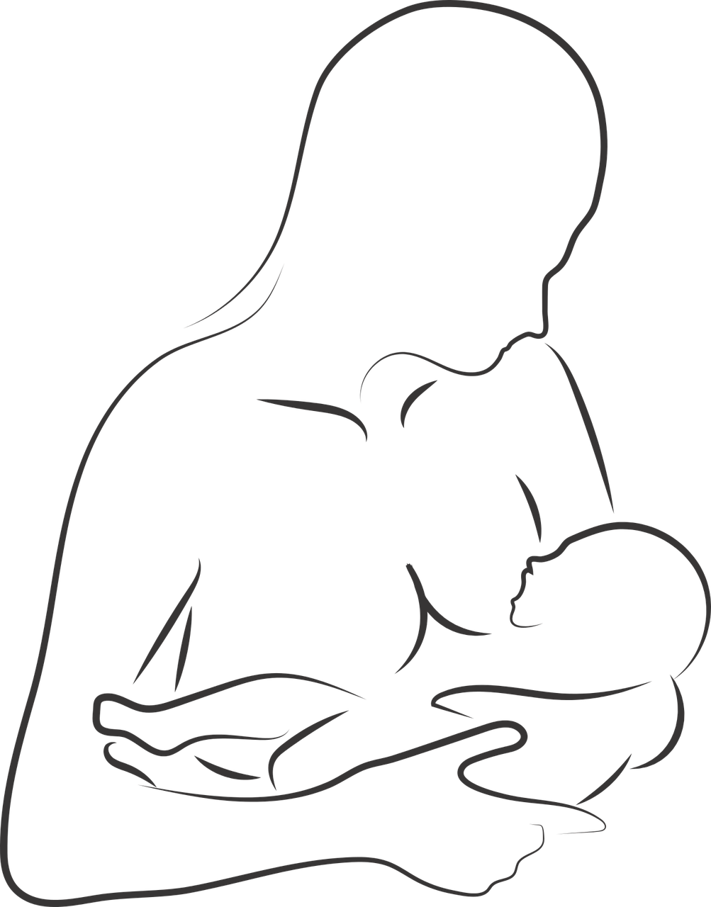
Purpose
Persuade the audience that the act of mothers breastfeeding their offspring should not be criticized, but normalized.
Persuade the audience to be more comfortable with mothers’ nursing their offsprings in public.
Share the benefits of breastfeeding babies for the mother as well as the offspring.

Slide 5

“Many medical experts, including the American Academy of Pediatrics (AAP) and the American College of Obstetricians and Gynecologists, strongly recommend breastfeeding exclusively (no formula, juice, or water) for 6 months. And breastfeeding for a year at least with other foods which should be started at 6 months of age, such as vegetables, grains, fruits, proteins.”
(Brennan, 2019, p1)

Slide 6
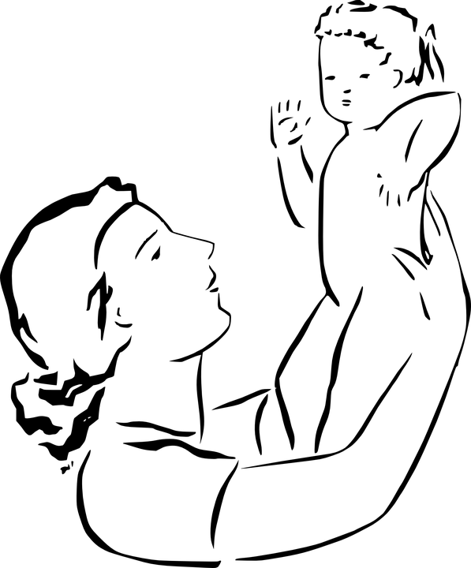
Benefits of Breastfeeding for Mothers
Enhances mother and child bonding.
Minimizes the risk of breast and ovarian cancer.
Helps with weight loss following pregnancy.
Causes the uterus to shrink back to normal size. (Pre-pregnancy size)
Minimizes the risk of mother contracting osteoporosis.
Heals the body after delivery.
Saves time and money.

Slide 7
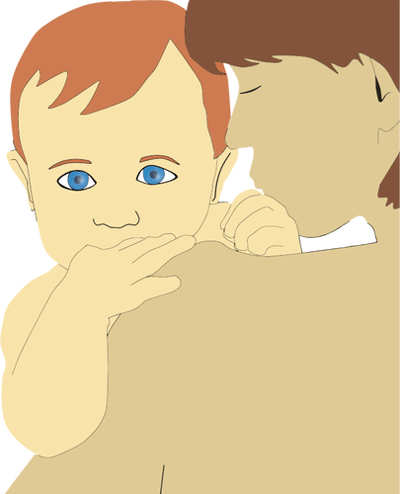
Benefits of Breastfeeding for Offspring
Protects the baby against allergies and eczema
Causes the baby to have less stomach problems such as diarrhea and constipation.
Minimizes the risk of the baby contracting viruses and infections.
Reduces the risk of SIDS
Fights against common diseases such as spinal meningitis and type 1 diabetes
Essential for the emotional and physical development of the child.
Brings you and your baby closer with skin to skin contact.

Slide 8
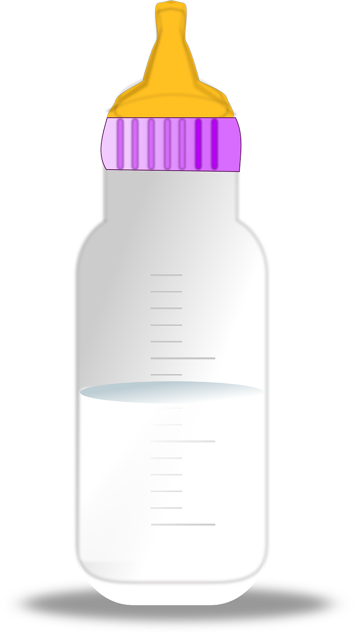
Fun Fact
“Breast milk is nature's perfect baby food. It contains immunity-boosting antibodies and healthy enzymes that scientists have yet to replicate.”
(Lucille/Hartshorne, 2020)

Slide 9
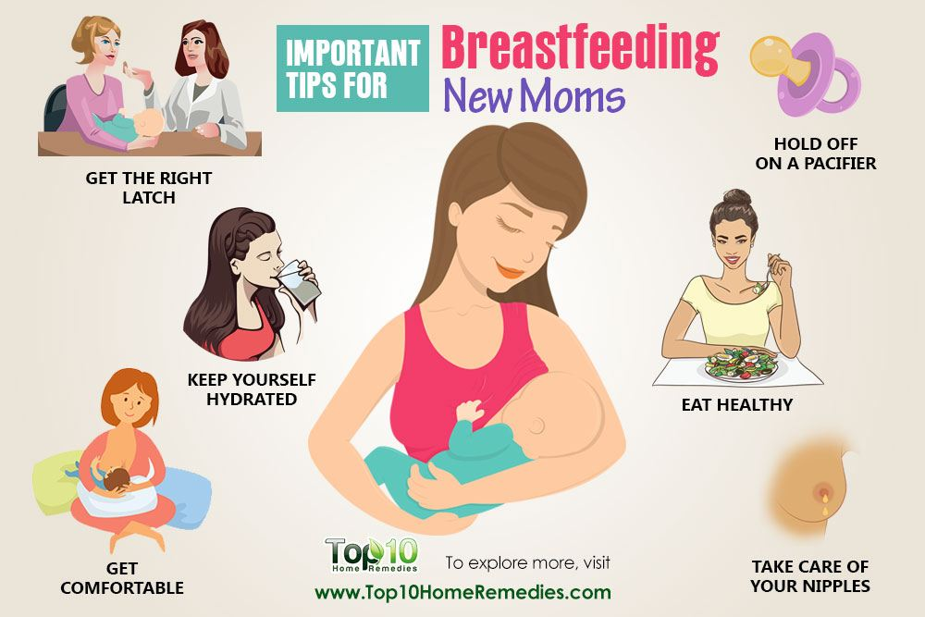
Tips for Mothers Breastfeeding or Planning to Breastfeed

Slide 10
References
Brennan, D. B. (2019, December 10). Breastfeeding Overview. Retrieved April 26, 2020, from https://www.webmd.com/parenting/baby/nursing-basics#1
Lucia, C. A., & Lucia, C. A. (n.d.). The Benefits of Breastfeeding. Retrieved from https://www.parents.com/baby/breastfeeding/basics/the-benefits-of-breastfeeding/
Team, T. H. R. (2018). Retrieved from https://www.top10homeremedies.com/pregnancy/important-breastfeeding-tips-new-moms.html

